Slide 1
COMP3017 Service Computing

Slide 2

Module One: Introduction to Service Computing and XML-RPC

Slide 3
Our textbook for this module:
Ethan Cerami, Web Services Essentials, Publisher：O’Reilly，ISBN：9780596002244，
Chapters:
Chapter 1 - Introduction to Web Services
Chapter 2 - XML-RPC

Slide 4
Intended learning outcomes
After completing activities in this module, you will:
Understand the basics of web service terminology and architecture
Understand how the main web service technologies work together
Understand the main concepts and history of XML-RPC
Be able to use XML-RPC in different scenarios
Understand the XML-RPC data types, requests, responses and other technical details

Slide 5
Guided questions for Module 1
What is a service?
What is a web-service?
What is a web-service protocol stack?
What is XML messaging?
What is service description?
What is service discovery?
What is XML-RPC
What is XML?
What is SOAP?
What is WSDL?
What is UDDI?

Slide 6
Guided questions for Module 1
What is the relationship between XML, XML-RPC, and SOAP?
What is the relationship between SOAP, WSDL, and UDDI?
What is the relationship between WSDL and service description?
What is the relationship between UDDI and service discovery?
What are the three main actors in service architecture?
What are the steps in a typical development plan for a service requestor?
How do we develop web services from the service provider perspective?

Slide 7
Guided questions for Module 1
Why do we use XML-RPC when developing services? What are its advantages?
How do we publish services with XML-RPC?
Combination of what three parts defines a complete RPC?
What data types are defined in XML-RPC specification and how are they represented?
What elements are in XML-RPC request?
What elements are in XML-RPC response?
How developer uses XML-RPC?

Slide 8
Review – vision of service computing

Slide 9
Review – vision of service computing
But how to achieve it?

Slide 10
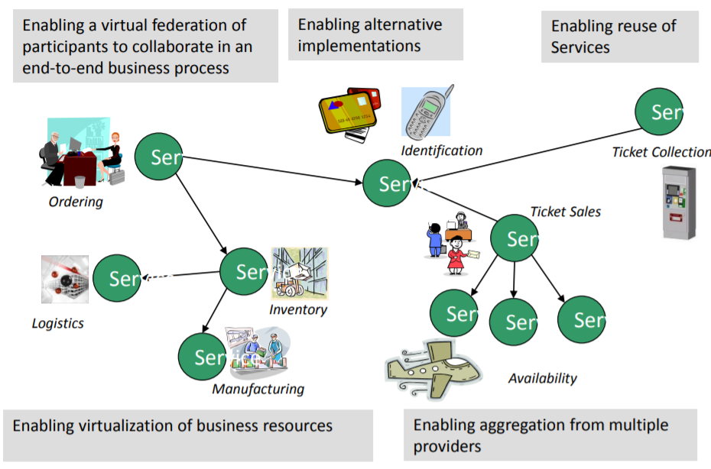
Motivation - ENABLE FLEXIBLE, FEDERATED BUSINESS PROCESSES
Enable flexible, federated business processes

Slide 11
Service oriented architecture
Service-oriented architecture (SOA) is a type of software design that makes software components reusable using service interfaces that use a common communication language over a network.
SOA integrates software components that have been separately deployed and maintained and allows them to communicate and work together to form software applications across different systems.

Slide 12
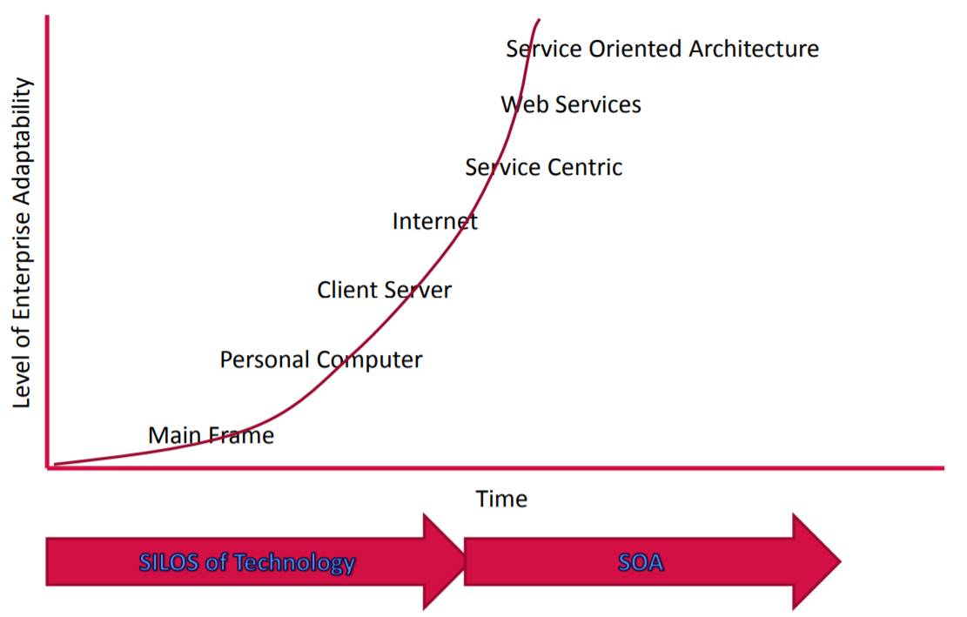
Towards Service Computing in an Enterprise

Slide 13
Client-server vs service orientation
A distributed application structure that partitions tasks or workloads between providers of the resource and requestors
Program is split into two parts
Server – a provider of some function
Client – requestor of the function
Client and server can be deployed on different machines
Many clients can connect to one server

Slide 14
Client-server vs service orientation
Traditional client-server – more coupled
The server exists for a specific client, without planning for re-use
In service orientation – decoupling
the server side is very independent of the client
Many different client types use the same server
In this way SOA services are designed for reuse
Coupling = 耦合性

Slide 15
Client-server vs service orientation
The traditional client-server model often lacks well-defined public contracts that are independent of the client or server implementation
this means a client is tied to a particular server
In Service Computing
components publish and use services in a peer-to-peer manner
a client is not tied to a particular server
service providers are interchangeable

Slide 16
Object orientation vs service orientation
Object oriented programing is built on the premise that programming problems can be modelled in terms of the objects in the problem domain
focuses on what things are and how they are constructed
Service oriented programming adds the premise that problems can be modelled in terms of the services that an object provides or uses
focuses on what things can do

Slide 17
Service oriented architecture
Service-oriented architecture (SOA) is a type of software design that makes software components reusable using service interfaces that use a common communication language over a network
SOA integrates software components that have been separately deployed and maintained and allows them to communicate and work together to form software applications across different systems

Slide 18
Service
Services represent a type of relationships-based interactions (activities) between at least one service provider and one service consumer to achieve a certain business goal or solution objective.

Slide 19
Driver App
Map functions
Module 1
Module 2
Module 3
Module 4
Module 5
Module 6
Module 7
…
Warehouse App
Map functions
Module 1
Module 2
Module 3
Module 4
Module 5
Module 6
Module 7
…
Sales App
Map functions
Module 1
Module 2
Module 3
Module 4
Module 5
Module 6
Module 7
…

Slide 20
Driver App
Service consumer
Module 1
Map functions
Module 2
Module 3
Module 4
Module 5
Module 6
Module 7
…
Warehouse App
Map Service Provider
Service consumer
Module 1
Map functions
Module 2
Interface
Map functions
Module 3
Module 4
Module 5
Module 6
Module 7
…
Sales App
Communication language
Service consumer
Module 1
Map functions
Module 2
Module 3
Module 4
Module 5
Module 6
Module 7
…

Slide 21
Service Provider
Service consumer
Communication language
Interface
Functions

Slide 22
Underlying technologies
Web services
Service-oriented architecture (SOA)
Cloud computing
Business process modelling
….

Slide 23
End of a review

Slide 24
Let’s consider an example first
You are a developer for an enterprise Widgets Inc. that sells its products through its web site
Just a basic e-commerce functionality
Customers can purchase parts and check on order status

Slide 25
The current system in the enterprise is not service oriented
Human centric web
Humans are primary actors initiating requests

Slide 26
The Human Centric Web – approach without services
HTTP GET: “What
is the status of
my order?”
Web
Browser
Web
Server
HTTP Response
with HTML Page:
“Leaving the warehouse
at 3 pm today.”
This illustrates a human-centric web, where humans are the primary actors initiating web requests.

Slide 27
Application-Centric Web – service oriented approach
With services, we move from a human-centric web to an application-centric web.
In other words, conversations between applications occur as easily as conversations between web browsers and servers.

Slide 28
The Application-Centric Web
XML Request: “What
is the status of
my order?”
Inventory
Application
Web
Server
On to
human
users
XML Response:
“Leaving the warehouse at 3 pm today.”
On to
other applications
The order status is now a service.
Applications can therefore connect to the order status service directly.

Slide 29
Application-Centric Web
There are numerous areas where an application-centric web would be extremely helpful:
credit card verification
package tracking
shopping bots
single sign-on registration
calendar, email, etc.

Slide 30
What kind of technology support is needed to move from human centric web to application centric web?
What mechanisms do we need?

Slide 31
Here are some ideas
Service discovery mechanisms
A way for the applications that need services to find providers of the services
Service description mechanism
A way for the service clients to know what services providers provide
A way for the providers of the services to describe the services they offer
Common standards
A way for service clients to communicate with service providers
Interoperability support
…

Slide 32
→ Web service are one of the technologies that provide such mechanisms

Slide 33
What is a Web Service?

Slide 34
What is a Web Service?
A Web Service is any service that:
Is available over the Internet or private (intranet) networks
Uses a standardized XML messaging system
Is not tied to any one operating system or programming language

Slide 35
Web services are based on standards
A web service makes software application resources available over networks using standard technologies
Web services standards are the glue that allows computers and devices to interact, forming a greater computing whole that can be accessed from any device on the network

Slide 36
Web services are based on standards
A web service makes software application resources available over networks using standard technologies
Web services standards are the glue that allows computers and devices to interact, forming a greater computing whole that can be accessed from any device on the network

Slide 37
Standardization
The implementation of standards in industry

Slide 38
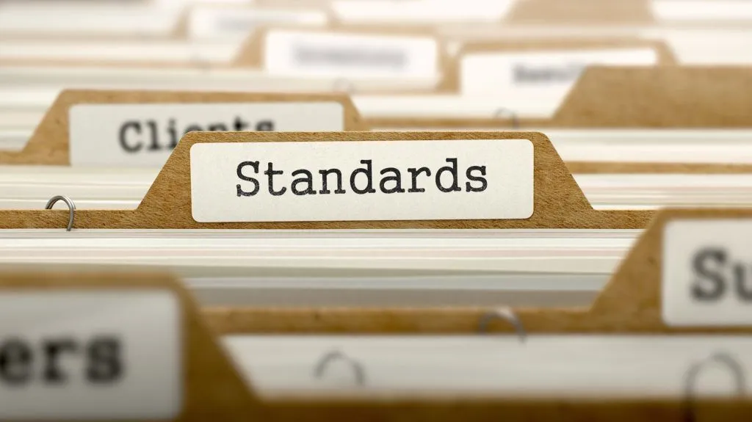
Standardization – definition (1)
The implementation of standards in industry

Slide 39
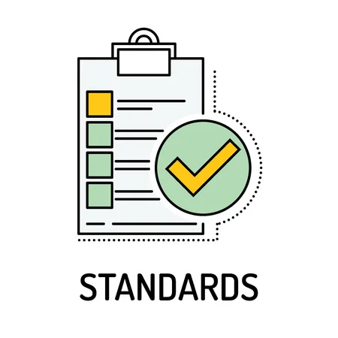
Standard
A standard is a repeatable, harmonised, agreed and documented way of doing something
Standards contain technical specifications or other precise criteria designed to be used consistently as a rule, guideline, or definition

Slide 40
Standard
As defined by ISO (International Standards Organization)
“A standard is a document, established by a consensus of subject matter experts and approved by a recognized body that provides guidance on the design, use or performance of materials, products, processes, services, systems or persons”.

Slide 41
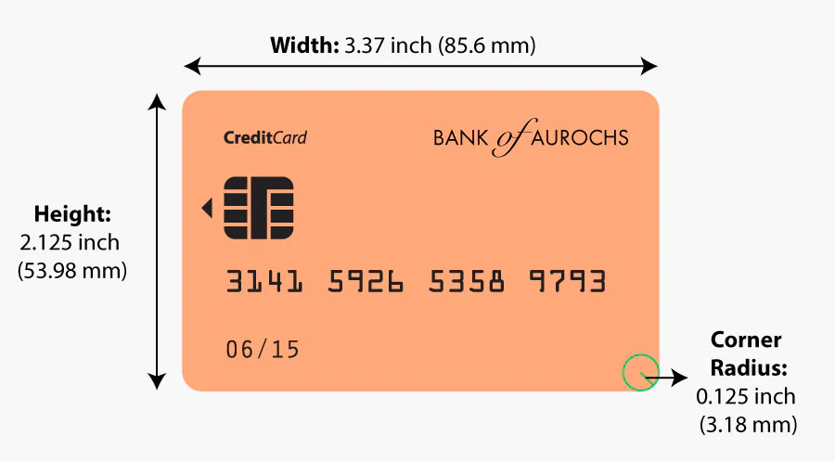
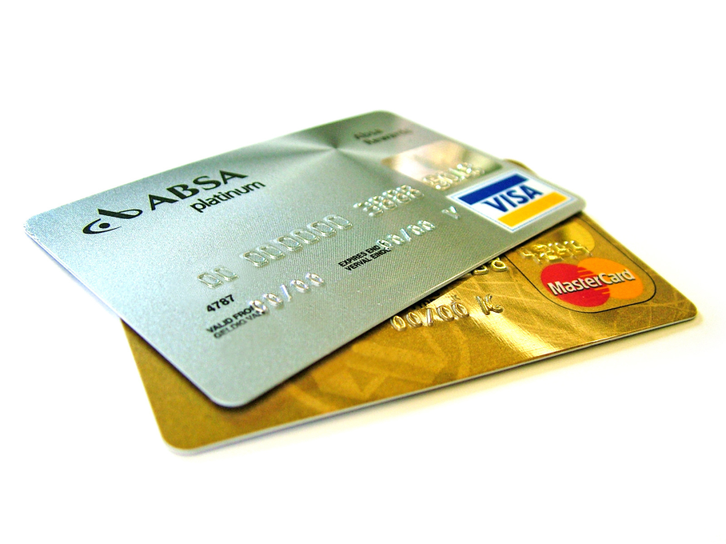
Standard - example
The size of payment cards (ATM cards, credit cards, debit cards, etc.) is 85.60 by 53.98 millimetres and rounded corners with a radius of 2.88–3.48 millimetres
conforming to the ISO/IEC 7810 ID-1 standard “Identification cards — Physical characteristics”

Slide 42
Standardization – definition (2)
The process of creating protocols to guide the creation of goods or services based on the consensus of all the relevant parties in the industry

Slide 43
Standardization purpose (1)
The standards ensure that goods or services produced in a specific industry come with consistent quality and are equivalent to other comparable products or services in the same industry

Slide 44
Standardization purpose (2)
Standardization helps in ensuring the safety, interoperability, and compatibility of goods produced

Slide 45
Industry standardization examples
Parties | Mutual gains | Problem | Solution
Mechanical industry companies | Suppliers interchange, stock gains, etc. | Screw thread compatibility | Screw thread standard specifications
Pharmaceutical industry and medic community | Enable medical prescriptions, suppliers interchange, etc. | Drug uniformity | Drug standard specifications
Banks and specialized payment cards companies | Enable Credit card holder to pay a merchant for goods and services | Credit card uniformity | Credit card technical specifications

Slide 46
Who creates standards
Parties involved in the standardization processes:
Users
Interest groups
Corporations
Industrial or manufacturing associations
Professional societies
Governments
Standards organizations
…

Slide 47
Technical standard
A technical standard is an established norm or requirement for a repeatable technical task which is applied to a common and repeated use of rules, conditions, guidelines or characteristics for products or related processes and production methods, and related management systems practices

Slide 48
Technical standard
A technical standard includes
definition of terms
classification of components
delineation of procedures
specification of dimensions, materials, performance, designs, or operations
measurement of quality and quantity in describing materials processes, products, systems, services, or practices
test methods and sampling procedures
measurements of size or strength

Slide 49
Types of technical standards
A standard specification
A standard test method
A standard practice/procedure
A standard guide
A standard definition
Standard units

Slide 50
Standard specification
An explicit set of requirements for an item, material, component, system or service
It is often used to formalize the technical aspects of a procurement agreement or contract
For example, there may be a specification for a turbine blade for a jet engine that defines the exact material and performance requirements

Slide 51
Web services standards
Web services are a general term for technologies and standards for designing, developing, and managing programmable access Web components through standard descriptive interfaces (Web Services Description Language) and SOAP (Simple Object Access Protocol).
https://www.ibm.com/docs/en/rsm/7.5.0?topic=overview-web-services-standards

Slide 52
Web service standards
XML
XML-RPC
SOAP
WSDL
UDDI
…

Slide 53
What is a Web Service?
A Web Service is any service that:
Is available over the Internet or private (intranet) networks
Uses a standardized XML messaging system
Is not tied to any one operating system or programming language

Slide 54
A Basic Web Service
XML
XML
Computer A:
Language: Perl
Operating System: Windows 2000
Computer B:
Language: Java Operating System: Linux

Slide 55
XML Messaging
XML-RPC
There are several alternatives for XML messaging:
XML Remote Procedure Calls (XML-RPC)
SOAP
Regular XML transported over HTTP
Any of these options are valid.
SOAP
HTTP POST/GET
XML Document

Slide 56
Web Services Defined
Although not required, a web service may also have two additional (and desirable) properties:
a web service should be self describing.
a web service should be discoverable.

Slide 57
Web Services: Self Describing
If you publish a new web service, you should also publish a public interface to the service.
At a minimum, you should include human-readable documentation so that others can easily integrate your service.
If you have created a SOAP service, you should also include a public interface written in a common XML grammar.

Slide 58
Web Services: Discoverable
If you create a web service, there should be a relatively simple mechanism to publish this fact.
Likewise, interested parties should be able to easily discover your service.
The discovery service could be completely decentralized or completely centralized.

Slide 59
Web Services: Summary
To summarize, a complete web service is any service that:
Is available over the Internet or private (intranet) networks
Uses a standardized XML messaging system
Is not tied to any one operating system or programming language
Is self-describing via a common XML grammar
Is discoverable via a simple find mechanism

Slide 60
Web Services Architecture

Slide 61
Web Service Architecture
There are two ways to view the web service architectural framework:
Examine individual roles of each web service actor
Examine the web service protocol stack

Slide 62
Web Service Roles
Three major roles in web services:
Service Provider: provider of the web service.
Service Requestor: any consumer of the web service.
Service Registry: logically centralized directory of services.

Slide 63
Web Service Roles
1
Discover
Services
Service
Registry
Service
Requestor
Service
Provider
2
Invoke Service

Slide 64
Web Service Protocol Stack
Service transport: responsible for transporting messages.
Examples: HTTP, BEEP
XML messaging: responsible for encoding messages in common XML format.
Examples: XML-RPC, SOAP
Service Description: responsible for describing an interface to a specific web service.
Example: WSDL
Service Discovery: responsible for centralizing services into a common search registry.
Example: UDDI.

Slide 65
Web Service Protocol Stack
Searching / Publishing Web Services
Discovery
UDDI
Description
WSDL
Describing Web Services interface
XML Messaging
XML-RPC, SOAP, Custom XML
Transport
HTTP, SMTP, FTP, BEEP
Encoding messages in XML format
Transporting XML messages between client and server

Slide 66
Part II: Web Service Protocols

Slide 67
XML Messaging

Slide 68
Discovery
UDDI
Description
WSDL
XML Messaging
XML-RPC, SOAP, Custom XML
Transport
HTTP, SMTP, FTP, BEEP
Encoding messages in XML format
1
Discover
Services
Service
Registry
Service
Requestor
Service
Provider
2
Invoke Service

Slide 69
Option 1: XML-RPC

Slide 70
Option 1: XML-RPC
XML-RPC: protocol that uses XML messages to perform Remote Procedure Calls (RPC.)
Platform independent; diverse applications can talk to each other.
XML-RPC is the easiest way to get started with web services.
Simpler than SOAP
Simpler data structures for transmitting data.

Slide 71
XML-RPC Example
Here is a sample XML-RPC request to a weather service:
<?xml version="1.0" encoding="ISO-8859-1"?>
<methodCall>
<methodName>weather.getWeather</methodName>
<params>
<param><value>10016</value></param>
</params>
</methodCall>
“Give me the current weather conditions
in zip code: 10016.”

Slide 72
XML-RPC Example
Here is a sample XML-RPC request to a weather service:
<?xml version="1.0" encoding="ISO-8859-1"?>
<methodCall>
<methodName>weather.getWeather</methodName>
<params>
<param><value>10016</value></param>
</params>
</methodCall>
“Give me the current weather conditions
in zip code: 10016.”

Slide 73
XML-RPC Example
Here is a sample XML-RPC request to a weather service:
<?xml version="1.0" encoding="ISO-8859-1"?>
<methodCall>
<methodName>weather.getWeather</methodName>
<params>
<param><value>10016</value></param>
</params>
</methodCall>
“Give me the current weather conditions
in zip code: 10016.”

Slide 74
XML-RPC Example
Here is a sample Weather response:
<?xml version="1.0" encoding="ISO-8859-1"?>
<methodResponse>
<params>
<param>
<value><int>65</int></value>
</param>
</params>
</methodResponse>
“Current temperature is 65 degrees”

Slide 75
XML-RPC Example
Here is a sample Weather response:
<?xml version="1.0" encoding="ISO-8859-1"?>
<methodResponse>
<params>
<param>
<value><int>65</int></value>
</param>
</params>
</methodResponse>
“Current temperature is 65 degrees”

Slide 76
Option 2: SOAP

Slide 77
Option 2: SOAP
SOAP: used to stand for “Simple Object Access Protocol”
XML-Based protocol for exchanging information between computers.

Slide 78
SOAP Message Format
SOAP Message
Envelope (Required)
Header (Optional)
Body (Required)
Fault (Optional: Response only)

Slide 79
SOAP 1.1 Example
Here is a sample SOAP request to a weather service:
<?xml version='1.0' encoding='UTF-8'?>
<SOAP-ENV:Envelope
xmlns:SOAP-ENV="http://www.w3.org/2001/09/soap-envelope/"
xmlns:xsi="http://www.w3.org/2001/XMLSchema-instance"
xmlns:xsd="http://www.w3.org/2001/XMLSchema">
<SOAP-ENV:Body>
<ns1:getWeather
xmlns:ns1="urn:examples:weatherservice"
SOAP-ENV:encodingStyle="http://www.w3.org/2001/09/soap-encoding/">
<zipcode xsi:type="xsd:string">10016</zipcode>
</ns1:getWeather>
</SOAP-ENV:Body>
</SOAP-ENV:Envelope>

Slide 80
SOAP 1.1 Example
“Give me the current weather conditions
in zip code: 10016.”
Here is a sample SOAP request to a weather service:
<?xml version='1.0' encoding='UTF-8'?>
<SOAP-ENV:Envelope
xmlns:SOAP-ENV="http://www.w3.org/2001/09/soap-envelope/"
xmlns:xsi="http://www.w3.org/2001/XMLSchema-instance"
xmlns:xsd="http://www.w3.org/2001/XMLSchema">
<SOAP-ENV:Body>
<ns1:getWeather
xmlns:ns1="urn:examples:weatherservice"
SOAP-ENV:encodingStyle="http://www.w3.org/2001/09/soap-encoding/">
<zipcode xsi:type="xsd:string">10016</zipcode>
</ns1:getWeather>
</SOAP-ENV:Body>
</SOAP-ENV:Envelope>

Slide 81
SOAP 1.1 Example:
Here is a sample SOAP response:
<?xml version='1.0' encoding='UTF-8'?>
<SOAP-ENV:Envelope
xmlns:SOAP-ENV="http://www.w3.org/2001/09/soap-envelope/"
xmlns:xsi="http://www.w3.org/2001/XMLSchema-instance"
xmlns:xsd="http://www.w3.org/2001/XMLSchema">
<SOAP-ENV:Body>
<ns1:getWeatherResponse
xmlns:ns1="urn:examples:weatherservice"
SOAP-ENV:encodingStyle="http://www.w3.org/2001/09/soap-encoding/">
<return xsi:type="xsd:int">65</return>
</ns1:getWeatherResponse>
</SOAP-ENV:Body>
</SOAP-ENV:Envelope>

Slide 82
SOAP 1.1 Example:
“Current temperature is 65 degrees”
Here is a sample SOAP response:
<?xml version='1.0' encoding='UTF-8'?>
<SOAP-ENV:Envelope
xmlns:SOAP-ENV="http://www.w3.org/2001/09/soap-envelope/"
xmlns:xsi="http://www.w3.org/2001/XMLSchema-instance"
xmlns:xsd="http://www.w3.org/2001/XMLSchema">
<SOAP-ENV:Body>
<ns1:getWeatherResponse
xmlns:ns1="urn:examples:weatherservice"
SOAP-ENV:encodingStyle="http://www.w3.org/2001/09/soap-encoding/">
<return xsi:type="xsd:int">65</return>
</ns1:getWeatherResponse>
</SOAP-ENV:Body>
</SOAP-ENV:Envelope>

Slide 83

Open Question
Points: 10
What is the main difference between XML-RPC and SOAP?
Open Question is only supported on Version 2.0 or newer.
Answer

Slide 84
Weather request
<?xml version="1.0" encoding="ISO-8859-1"?>
<methodCall>
<methodName>weather.getWeather</methodName>
<params>
<param><value>10016</value></param>
</params>
</methodCall>
XML-RPC
<?xml version='1.0' encoding='UTF-8'?>
<SOAP-ENV:Envelope
xmlns:SOAP-ENV="http://www.w3.org/2001/09/soap-envelope/"
xmlns:xsi="http://www.w3.org/2001/XMLSchema-instance"
xmlns:xsd="http://www.w3.org/2001/XMLSchema">
<SOAP-ENV:Body>
<ns1:getWeather
xmlns:ns1="urn:examples:weatherservice"
SOAP-ENV:encodingStyle="http://www.w3.org/2001/09/soap-encoding/">
<zipcode xsi:type="xsd:string">10016</zipcode>
</ns1:getWeather>
</SOAP-ENV:Body>
</SOAP-ENV:Envelope>
SOAP

Slide 85
Weather response
<?xml version="1.0" encoding="ISO-8859-1"?>
<methodResponse>
<params>
<param>
<value><int>65</int></value>
</param>
</params>
</methodResponse>
XML-RPC
<?xml version='1.0' encoding='UTF-8'?>
<SOAP-ENV:Envelope
xmlns:SOAP-ENV="http://www.w3.org/2001/09/soap-envelope/"
xmlns:xsi="http://www.w3.org/2001/XMLSchema-instance"
xmlns:xsd="http://www.w3.org/2001/XMLSchema">
<SOAP-ENV:Body>
<ns1:getWeatherResponse
xmlns:ns1="urn:examples:weatherservice"
SOAP-ENV:encodingStyle="http://www.w3.org/2001/09/soap-encoding/">
<return xsi:type="xsd:int">65</return>
</ns1:getWeatherResponse>
</SOAP-ENV:Body>
</SOAP-ENV:Envelope>
SOAP

Slide 86
XML-RPC vs SOAP
XML-RPC is the easiest way to get started with web services.
Simpler than SOAP
Simpler data structures for transmitting data.

Slide 87
Discovery
UDDI
Description
WSDL
Describing Web Services interface
XML Messaging
XML-RPC, SOAP, Custom XML
Transport
HTTP, SMTP, FTP, BEEP
1
Discover
Services
Service
Registry
Service
Requestor
Service
Provider
2
Invoke Service

Slide 88
WSDL
WSDL: Web Service Description Language.
WSDL is an XML grammar for specifying an interface for a web service.
Specifies
location of web service
methods that are available by the web service
data type information for all XML messages
WSDL is commonly used to describe SOAP services.

Slide 89
WSDL In a Nutshell
<definitions>: Root WSDL Element
<types>: What data types will be transmitted?
<message>: What messages will be transmitted?
<portType>: What operations (functions) will be supported?
<binding>: What SOAP specific details are there?
<service>: Where is the service located?

Slide 90
WSDL Excerpt: Weather Service
<message name="getWeatherRequest">
<part name="zipcode" type="xsd:string"/>
</message>
<message name="getWeatherResponse">
<part name="temperature" type="xsd:int"/>
</message>
<portType name="Weather_PortType">
<operation name="getWeather">
<input message="tns:getWeatherRequest"/>
<output message="tns:getWeatherResponse"/>
</operation>
</portType>
…
<service name="Weather_Service">
<documentation>WSDL File for
Weather Service</documentation>
<port binding="tns:Weather_Binding"
name="Weather_Port">
<soap:address
location="http://ecerami.com/soap/servlet/rpcrouter"/>
</port>
</service>
</definitions>

Slide 91
WSDL Excerpt: Weather Service
<message name="getWeatherRequest">
<part name="zipcode" type="xsd:string"/>
</message>
<message name="getWeatherResponse">
<part name="temperature" type="xsd:int"/>
</message>
<portType name="Weather_PortType">
<operation name="getWeather">
<input message="tns:getWeatherRequest"/>
<output message="tns:getWeatherResponse"/>
</operation>
</portType>
<types>: What data types will be transmitted?

Slide 92
WSDL Excerpt: Weather Service
<message name="getWeatherRequest">
<part name="zipcode" type="xsd:string"/>
</message>
<message name="getWeatherResponse">
<part name="temperature" type="xsd:int"/>
</message>
<portType name="Weather_PortType">
<operation name="getWeather">
<input message="tns:getWeatherRequest"/>
<output message="tns:getWeatherResponse"/>
</operation>
</portType>
<types>: What data types will be transmitted?

Slide 93
WSDL Excerpt: Weather Service
<message name="getWeatherRequest">
<part name="zipcode" type="xsd:string"/>
</message>
<message name="getWeatherResponse">
<part name="temperature" type="xsd:int"/>
</message>
<portType name="Weather_PortType">
<operation name="getWeather">
<input message="tns:getWeatherRequest"/>
<output message="tns:getWeatherResponse"/>
</operation>
</portType>
<message>: What messages will be transmitted?

Slide 94
WSDL Excerpt: Weather Service
<message name="getWeatherRequest">
<part name="zipcode" type="xsd:string"/>
</message>
<message name="getWeatherResponse">
<part name="temperature" type="xsd:int"/>
</message>
<portType name="Weather_PortType">
<operation name="getWeather">
<input message="tns:getWeatherRequest"/>
<output message="tns:getWeatherResponse"/>
</operation>
</portType>
<message>: What messages will be transmitted?

Slide 95
WSDL Excerpt: Weather Service
<message name="getWeatherRequest">
<part name="zipcode" type="xsd:string"/>
</message>
<message name="getWeatherResponse">
<part name="temperature" type="xsd:int"/>
</message>
<portType name="Weather_PortType">
<operation name="getWeather">
<input message="tns:getWeatherRequest"/>
<output message="tns:getWeatherResponse"/>
</operation>
</portType>
<portType>: What operations (functions) will be supported?

Slide 96
WSDL Excerpt: Weather Service
<message name="getWeatherRequest">
<part name="zipcode" type="xsd:string"/>
</message>
<message name="getWeatherResponse">
<part name="temperature" type="xsd:int"/>
</message>
<portType name="Weather_PortType">
<operation name="getWeather">
<input message="tns:getWeatherRequest"/>
<output message="tns:getWeatherResponse"/>
</operation>
</portType>
<portType>: What operations (functions) will be supported?

Slide 97
WSDL Excerpt: Weather Service
<binding>: What SOAP specific details are there?
…
<service name="Weather_Service">
<documentation>WSDL File for
Weather Service</documentation>
<port binding="tns:Weather_Binding"
name="Weather_Port">
<soap:address
location="http://ecerami.com/soap/servlet/rpcrouter"/>
</port>
</service>
</definitions>

Slide 98
WSDL Excerpt: Weather Service
…
<service name="Weather_Service">
<documentation>WSDL File for
Weather Service</documentation>
<port binding="tns:Weather_Binding"
name="Weather_Port">
<soap:address
location="http://ecerami.com/soap/servlet/rpcrouter"/>
</port>
</service>
</definitions>
<service>: Where is the service located?

Slide 99
So What?
Given a WSDL file, a developer can immediately figure out how to connect to the web service.
Eases overall integration process.
Better yet, with WSDL tools, you can automate the integration…

Slide 100
Searching / Publishing Web Services
Discovery
UDDI
Description
WSDL
XML Messaging
XML-RPC, SOAP, Custom XML
Transport
HTTP, SMTP, FTP, BEEP
1
Discover
Services
Service
Registry
Service
Requestor
Service
Provider
2
Invoke Service

Slide 101
UDDI
UDDI: Universal Description, Discovery and Integration.
Currently represents the discovery layer in the protocol stack.
Originally created by Microsoft, IBM and Ariba.
Technical specification for publishing and finding businesses and web services.

Slide 102
UDDI: Two Parts
Part I: Technical specification
specification for building a distributed directory of businesses and services.
XML format for specifying businesses and services.
API for querying/publishing to the registry.
Part II: Implementation
UDDI Business Registry, fully operational implementation of the specification.
Businesses can publish services here.
Businesses can discover services here.
Currently maintained by IBM, Microsoft, etc.

Slide 103
UDDI Data
White Pages
Information about a specific company; name description, address, etc.
Yellow Pages
Classification data for company or service.
For example: industry, product or geographic codes.
Green Pages
Technical information about specific services.
Pointers to WSDL Files.

Slide 104
All Together Now!

Slide 105
Discover
Services
Service
Registry
Service
Requestor
Service
Provider
Invoke Service
Discovery
UDDI
Description
WSDL
XML Messaging
XML-RPC, SOAP, Custom XML
Transport
HTTP, SMTP, FTP, BEEP

Slide 106
Using the Protocols Together – service request perspective
Step 1:
Find Services via UDDI
Step 2:
Retrieve Service Description File:
WSDL or XML-RPC Instructions
Step 3:
Create XML-RPC or SOAP Client
Step 4:
Invoke Remote Service

Slide 107
Using the Protocols Together – service provider perspective
Step 1:
Create core functionality
Step 2:
Create an XML-RPC or SOAP service wrapper
Step 3:
Create WSDL service description
or XML-RPC integration instructions
Step 4:
Deploy service
Step 5:
Register new service via UDDI

Slide 108
Web Services example
AWS - Amazon Web Services
a cloud platform offering over 200 services from data centers globally
Amazon Simple Storage Service (Amazon S3)
Amazon SimpleDB
…
Millions of customers
Startups
Large enterprises
government agencies

